Slide 1


Cost‐effective Outbreak
Detection in Networks
Jure Leskovec
Joint work with Andreas Krause, Carlos
Guestrin, Christos Faloutsos, Jeanne
VanBriesen, and Natalie Glance

Slide 2
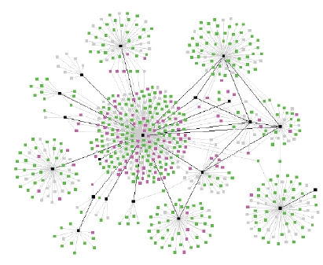
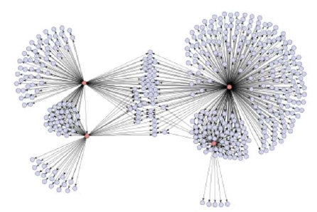
Diffusion in Social Networks
One of the networks is a spread of a disease,
the other one is product recommendations
Which is which? ☺

Slide 3
Diffusion in Social Networks
A fundamental process in social networks:
Behaviors that cascade from node to node like an
epidemic
– News, opinions, rumors, fads, urban legends, …
– Word‐of‐mouth effects in marketing: rise of new websites,
free web based services
– Virus, disease propagation
– Change in social priorities: smoking, recycling
– Saturation news coverage: topic diffusion among bloggers
– Internet‐energized political campaigns
– Cascading failures in financial markets
– Localized effects: riots, people walking out of a lecture

Slide 4
Empirical Studies of Diffusion
Experimental studies of diffusion have long history:
– Spread of new agricultural practices [Ryan‐Gross 1943]
• Adoption of a new hybrid‐corn between the 259 farmers in Iowa
• Classical study of diffusion
• Interpersonal network plays important role in adoption
Diffusion is a social process
– Spread of new medical practices [Coleman et al 1966]
• Studied the adoption of a new drug between doctors in Illinois
• Clinical studies and scientific evaluations were not sufficient to
convince the doctors
• It was the social power of peers that led to adoption

Slide 5
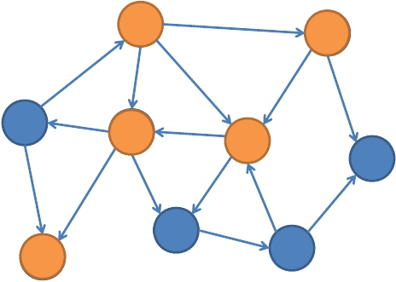
Diffusion in Networks
Initially some nodes are active
Active nodes spread their influence on the
other nodes, and so on …
a
d
b
f
e
h
g
c
i

Slide 6
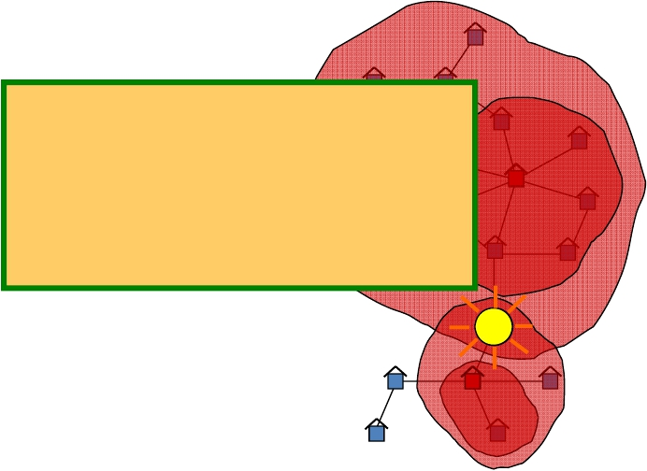
Scenario 1: Water Network
Given a real city water
distribution networknodes should we
And data on how
contaminants
the network detect the all possible
Problem posedcontaminations?
On which
by US
Environmental
Protection Agency
S

Slide 7
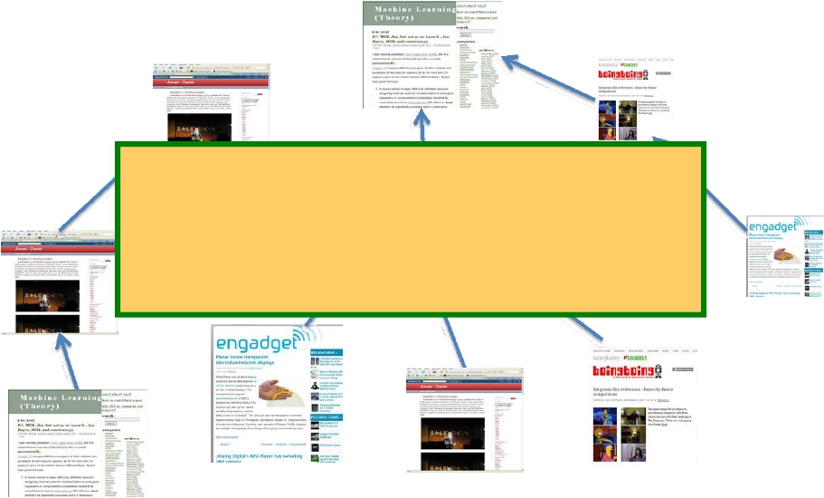
Scenario 2: Online media
Which news websites should
one read to detect new stories
as quickly as possible?

Slide 8
Cascade Detection: General Problem
Given a dynamic process spreading over the
network
We want to select a set of nodes to detect the
process effectively
Many other applications:
– Epidemics
– Network security

Slide 9
Two Parts to the Problem
Reward, e.g.:
– 1) Minimize time to detection
– 2) Maximize number of detected propagations
– 3) Minimize number of infected people
Cost (location dependent):
– Reading big blogs is more time consuming
– Placing a sensor in a remote location is expensive

Slide 10
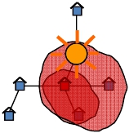
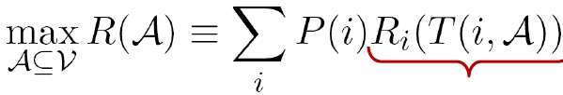
Problem Setting
Given a graph G(V,E)
and a budget B for sensors
and data on how contaminations spread over
the network:
– for each contamination i we know the time T(i, u)
when it contaminated node u
Select a subset of nodes A that maximize the
expected reward
S
subject to cost(A) < B
Reward for detecting
contamination i

Slide 11
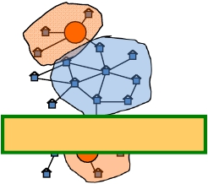
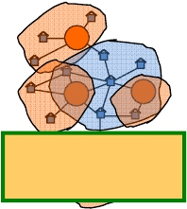
Structure of the Problem
Solving the problem exactly is NP‐hard
– Set cover (or vertex cover)
Observation: Diminishing returns
S1
New sensor:
S’
S1
S3
S2
Adding S’helps a lot
S2
Placement A={S1, S2}
Adding S’helps
very S 4little
Placement B={S1, S2, S3, S4}

Slide 12
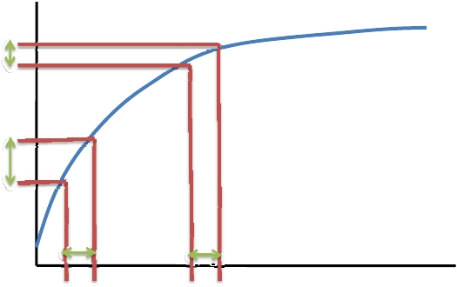
Analysis
Analysis: diminishing returns at individual nodes
implies diminishing returns at a “global” level
– Covered area grows slower and slower with
placement size
Reward R
(covered area)
Δ1
Δ1
Number of sensors

Slide 13
An Approximation Result
Diminishing returns: Covered area grows
slower and slower with placement size
R is submodular: if A ⊆ B then
R(A∪ {x}) – R(A) ≥ R(B∪ {x}) – R(B)
Theorem [Nehmhauser et al. ‘78]:
If f is a function that is monotone and
submodular, then k‐step hill‐climbing produces
set S for which f(S) is within (1‐1/e) of optimal.

Slide 14
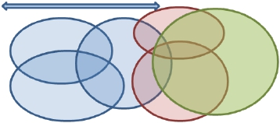
Reward functions: Submodularity
• We must show that R is submodular:
Benefit of adding a sensor to a
small placement
Benefit of adding a sensor to a
large placement
What do we know about submodular functions?
– 1) If R1, R2, …, Rk are submodular, and a1, a2, … ak > 0
then ∑aiRi is also submodular
– 2) Natural example: B
• Sets A1, A2, …, An:
• R(S) = size of union of Ai
x

Slide 15
Reward Functions are Submodular
Objective functions from Battle of Water
Sensor Networks competition [Ostfeld et al]:
– 1) Time to detection (DT)
• How long does it take to detect a contamination?
– 2) Detection likelihood (DL)
• How many contaminations do we detect?
– 3) Population affected (PA)
• How many people drank contaminated water?
are all submodular

Slide 16





Background: Submodular functions
What do we know about optimizing
Hill‐climbing
submodular functions?
reward
A hill‐climbing (i.e., greedy) is near
a
d
optimal (1-1/e (~63%) of optimal)
b
b
c
d
e
a
But
– 1) this only works for unit cost case
(each sensor/location costs the same)
– 2) Hill‐climbing algorithm is slow
• At each iteration we need to re‐evaluate
e
c
marginal gains
Add sensor with highest
marginal gain
• It scales as O(|V|B)

Slide 17
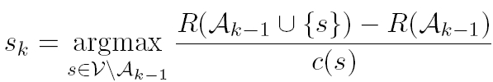
Towards a New Algorithm
Possible algorithm: hill‐climbing ignoring the cost
– Repeatedly select sensor with highest marginal gain
– Ignore sensor cost
It always prefers more expensive sensor with
reward r to a cheaper sensor with reward r‐ε
→ For variable cost it can fail arbitrarily badly
Idea
– What if we optimize benefit‐cost ratio?

Slide 18

Benefit‐Cost: More Problems
Bad news: Optimizing benefit‐cost ratio can
fail arbitrarily badly
Example: Given a budget B, consider:
– 2 locations s1 and s2:
• Costs: c(s1)=ε,c(s2)=B
What if we take best
• Only 1 cascade with reward: R(s1)=2ε, R(s2)=B
of ‐cost ratio
– Then benefit both solutions?
• bc(s1)=2 and bc(s2)=1
– So, we first select s1and then can not afford s2
→We get reward 2ε instead of B
Now send ε to 0 and we get arbitrarily bad

Slide 19
Solution: CELF Algorithm
CELF (cost‐effective lazy forward‐selection):
A two pass greedy algorithm:
• Set (solution) A: use benefit‐cost greedy
• Set (solution) B: use unit cost greedy
– Final solution: argmax(R(A), R(B))
How far is CELF from (unknown) optimal solution?
Theorem: CELF is near optimal
– CELF achieves ½(1-1/e) factor approximation
CELF is much faster than standard hill‐climbing

Slide 20
How good is the solution?
Traditional bound (1‐1/e) tells us:
How far from optimal are we even before
seeing the data and running the algorithm
Can we do better? Yes!
We develop a new tighter bound. Intuition:
– Marginal gains are decreasing with the solution size
– We use this to get tighter bound on the solution

Slide 21

Scaling up CELF algorithm
Observation:
Submodularity guarantees that marginal
benefits decrease with the solution size
reward
d
Idea: exploit submodularity, doing lazy
evaluations!
(considered by Robertazzi et al. for unit cost case)

Slide 22




Scaling up CELF
CELF algorithm – hill‐climbing:
reward
– Keep an ordered list of marginal
benefits bi from previous
iteration
– Re‐evaluate bi only for top
a
b
c
d
b
a
e
c
sensor
– Re‐sort and prune
d
e

Slide 23
Scaling up CELF
CELF algorithm – hill‐climbing:
reward
– Keep an ordered list of marginal
benefits bi from previous
iteration
– Re‐evaluate bi only for top
a
b
c
d
b
a
e
c
sensor
– Re‐sort and prune
d
e

Slide 24




Scaling up CELF
CELF algorithm – hill‐climbing:
reward
– Keep an ordered list of marginal
benefits bi from previous
iteration
– Re‐evaluate bi only for top
a
d
b
d
b
a
e
c
sensor
– Re‐sort and prune
e
c

Slide 25
Experiments: 2 Case Studies
We have real propagation data
– Blog network:
• We crawled blogs for 1 year
• We identified cascades – temporal propagation of
information
– Water distribution network:
• Real city water distribution networks
• Realistic simulator of water consumption provided
by US Environmental Protection Agency

Slide 26
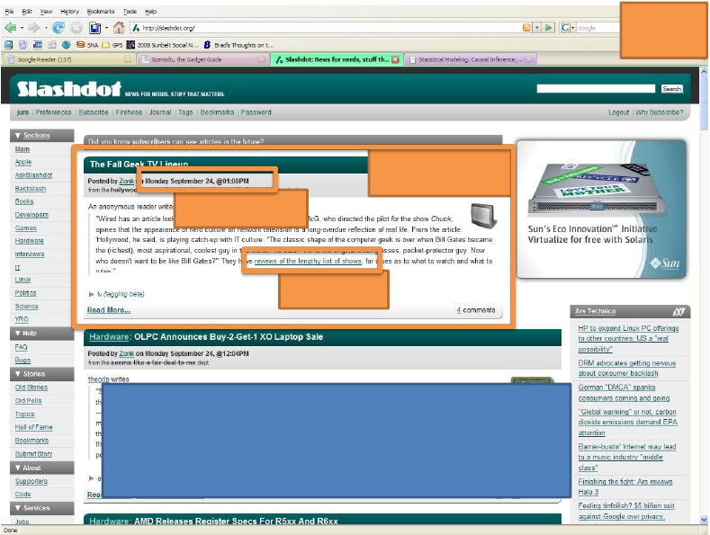
Case study 1: Cascades in Blogs
Blog
Blog post
Time stamp
hyperlink
We follow hyperlinks in time to obtain
cascades (traces of information
propagation)

Slide 27
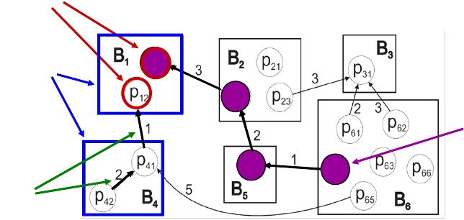
Diffusion in Blogs
Posts
Blogs
Information
cascade
Time
ordered
hyperlinks
Data – Blogs:
– We crawled 45,000 blogs for 1 year
– 10 million posts and 350,000 cascades

Slide 28
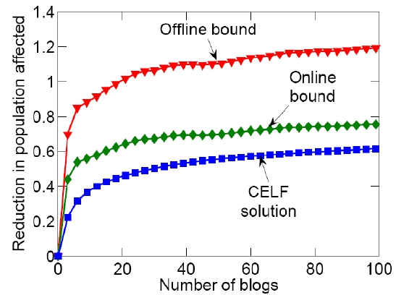
Q1: Blogs: Solution Quality
Our bound is much tighter
– 13% instead of 37%
Old bound
Our bound
CELF

Slide 29
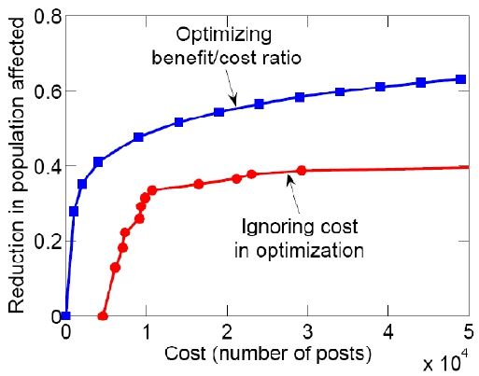
Q2: Blogs: Cost of a Blog
Unit cost:
– algorithm picks large
popular blogs:
instapundit.com,
michellemalkin.com
Variable cost:
– proportional to the
number of posts
We can do much
better when
considering costs
Variable cost
Unit cost

Slide 30
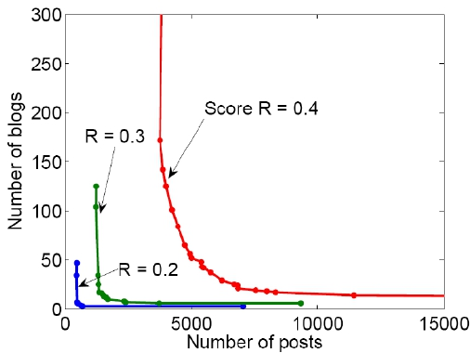
Q2: Blogs: Cost of a Blog
But then algorithm
picks lots of small
blogs that participate
in few cascades
We pick best solution
that interpolates
between the costs
We can get good
solutions with few
blogs and few posts
Each curve represents solutions with
same final reward

Slide 31
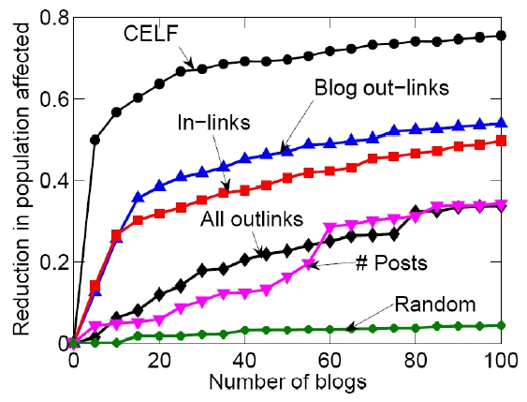
Q4: Blogs: Heuristic Selection
Heuristics perform much worse
One really needs to perform optimization

Slide 32
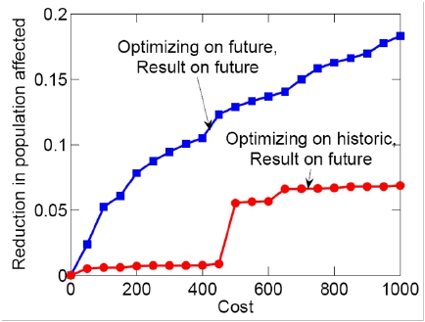
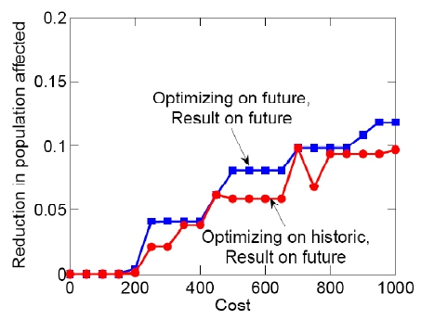
Blogs: Generalization to Future
We want to generalize well to future (unknown)
cascades
Limiting selection to bigger blogs improves
generalization

Slide 33
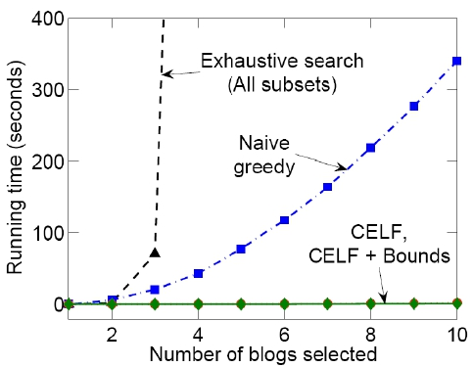
Q5: Blogs: Scalability
CELF runs 700
times faster than
simple hill‐climbing
algorithm

Slide 34
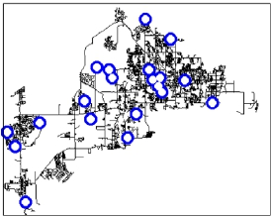
Case study 2: Water Network
Real metropolitan area
water network
– V = 21,000 nodes
– E = 25,000 pipes
Use a cluster of 50 machines for a month
Simulate 3.6 million epidemic scenarios
(152 GB of epidemic data)
By exploiting sparsity we fit it into main
memory (16GB)

Slide 35
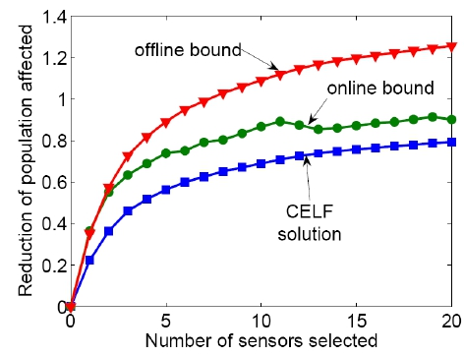
Water: Solution Quality
Old bound
Our bound
CELF
The new bound gives much better estimate of
solution quality

Slide 36
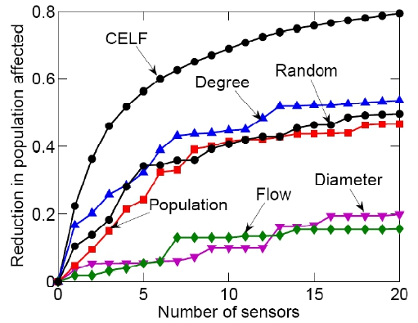
Water: Heuristic Placement
Heuristics placements perform much worse
One really needs to consider the spread of
epidemics

Slide 37
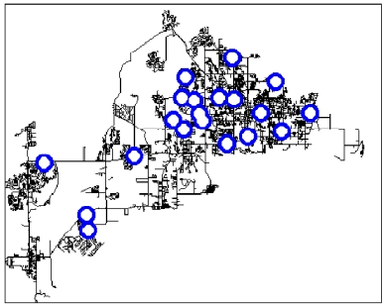
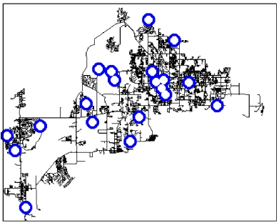
Water: Placement Visualization
Different reward functions give different
sensor placements
Population affected
Detection likelihood

Slide 38
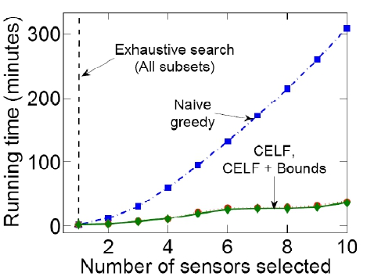
Water: Algorithm Scalability
CELF is an order of magnitude faster than
hill‐climbing

Slide 39
Results of BWSN competition
Author | #non‐dominated (out of 30)
CELF | 26
Berry et. al. | 21
Dorini et. al. | 20
Wu and Walski | 19
Ostfeld et al | 14
Propato et. al. | 12
Eliades et. al. | 11
Huang et. al. | 7
Guan et. al. | 4
Ghimire et. al. | 3
Trachtman | 2
Gueli | 2
Preis and Ostfeld | 39 1
Battle of Water
Sensor Networks
competition
[Ostfeld et al]:
count number of
non‐dominated
solutions

Slide 40
Other results
Many more details:
Fractional selection of the blogs
Generalization to future unseen cascades
Multi‐criterion optimization
We show that triggering model of Kempe et al
is a special case of out setting
40

Slide 41
Conclusion
General methodology for selecting nodes to
detect outbreaks
Results:
Submodularity observation
Variable‐cost algorithm with optimality guarantee
Tighter bound
Significant speed‐up (700 times)
Evaluation on large real datasets (150GB)
CELF won consistently
41

Slide 42
Conclusion and Connections
Diffusion of Topics
– How news cascade through on‐line networks
– Do we need new notions of rank?
Incentives and Diffusion
– Using diffusion in the design of on‐line systems
– Connections to game theory
When will one product overtake the other?

Slide 43
Further Connections
Diffusion of topics [Gruhl et al ‘04, Adar et al ‘04]:
– News stories cascade through networks of bloggers
– How do we track stories and rank news sources?
Recommendation incentive networks
[Leskovec‐Adamic‐Huberman ‘07]:
– How much reward is needed to make the product “work‐
of‐mouth” success?
Query incentive networks [Kleinberg‐Raghavan ‘05]:
– Pose a request to neighbors; offer reward for answer
– Neighbors can pass on request by offering (smaller)
reward
– How much reward is needed to produce an answer?

Slide 44
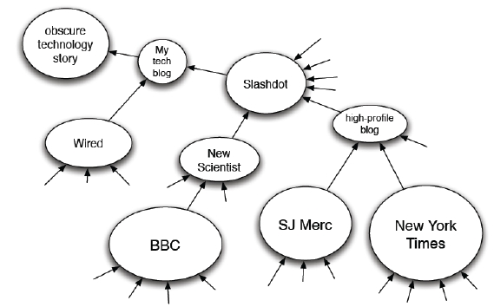
Topic Diffusion: what blogs to read?
News and discussion spreads via diffusion:
– Political cascades are different than technological cascades
Suggests new ranking measures for blogs

Slide 45
References
D. Kempe, J. Kleinberg, E. Tardos. Maximizing the Spread of
Influence through a Social Network. ACM KDD, 2003.
Jure Leskovec, Lada Adamic, Bernardo Huberman. The Dynamics
of Viral Marketing. ACM TWEB, 2007.
Jure Leskovec, Mary McGlohon, Christos Faloutsos, Natalie
Glance, Matthew Hurst. Cascading Behavior in Large Blog
Graphs. SIAM Data Mining, 2007.
Jure Leskovec, Ajit Singh, Jon Kleinberg. Patterns of Influence in
a Recommendation Network. PAKDD, 2006.
Jure Leskovec, Andreas Krause, Carlos Guestrin, Christos
Faloutsos, Jeanne VanBriesen, Natalie Glance. Cost‐effective
Outbreak Detection in Networks. ACM KDD, 2007.

